Slide 1
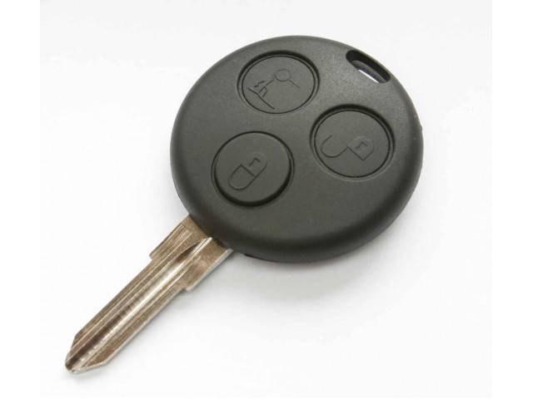
Smart Key System
Michael Fetick - 8427
Weilong Qu - 660162539
Bobby Ray Hurd - 76210
Yuxuan Guan - 660161473
Nithin Garrepally - 73600
Sheraz Karim - 660161500

Slide 2
Introduction – Smart Key
Do you think your car alarm system is secure enough?
What if your car is parked 4 blocks away and it is jacked by someone?
You want to monitor your car 24/7?
With affordable technology?

Slide 3
Introduction – Smart Key (Continued)
Feature RF technology to trigger alarm/vibration to your car key when your car alarm is active
Car security always in your hand

Slide 4
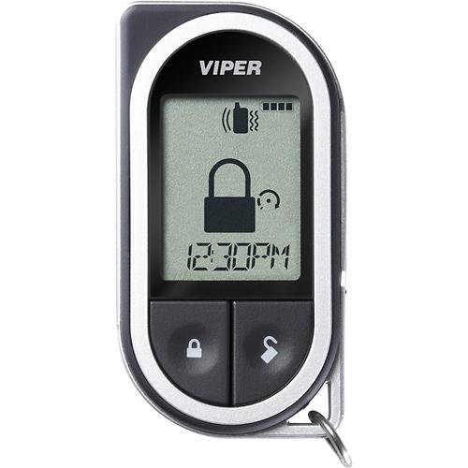
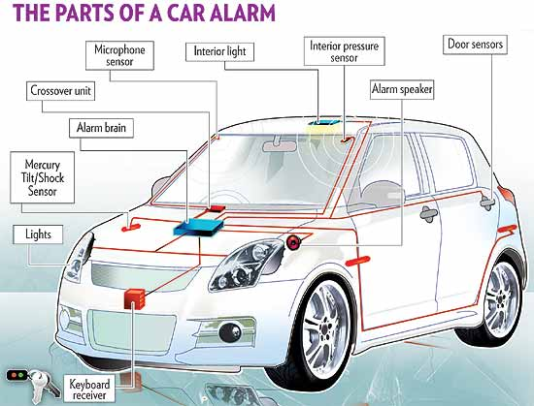
1. Identify the Opportunity
Existing Locking & Security System in Cars

Slide 5
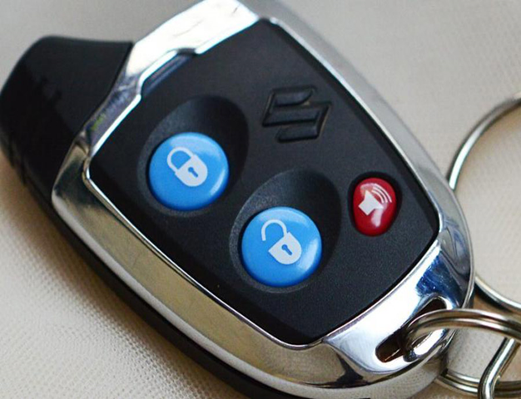
2. Determine the Objective
Type of Car Users
BMW
Sports Cars
Lexus etc
Customer Capacity
Rich Class
Moderate Income Class
Lower Income Class

Slide 6
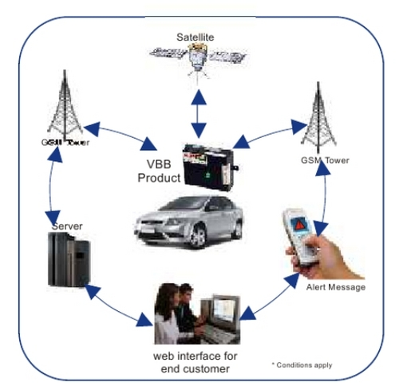
3. Determine the Alternatives
Different security system
Radio Frequency
Satellite Network
Built-in Modem

Slide 7
4. Collect & Arrange Data
Marketplace Needs – Registered Vehicles in the US

Slide 8
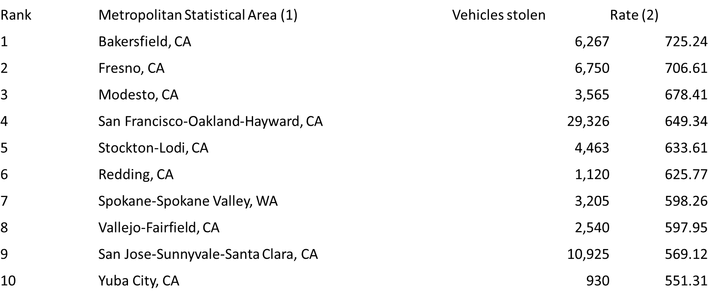
4. Collect & Arrange Data (Continued)
Marketplace Needs – Vehicles Stolen

Slide 9
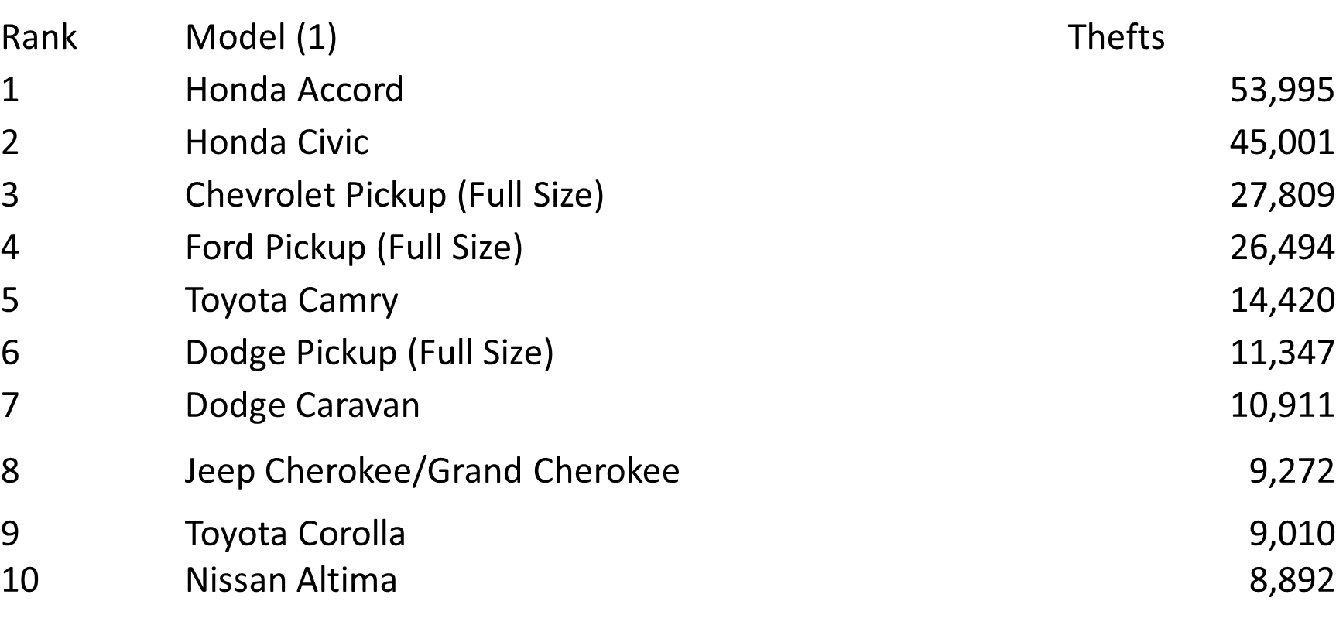
4. Collect & Arrange Data (Continued)
Marketplace Needs – Vehicles Stolen (By Brands)

Slide 10
4. Collect & Arrange Data (Continued)
According to the FBI, a motor vehicle is stolen every 44 seconds in the United States. In 2013, FBI reported there were an estimated 699,594 motor vehicle thefts nationwide.
10% vehicle owner would buy a anti-stolen system. Among them, 10% would choose our product, SMART KEY. TOTAL Marketplace Needs 2.53M pcs of SMART KEY

Slide 11
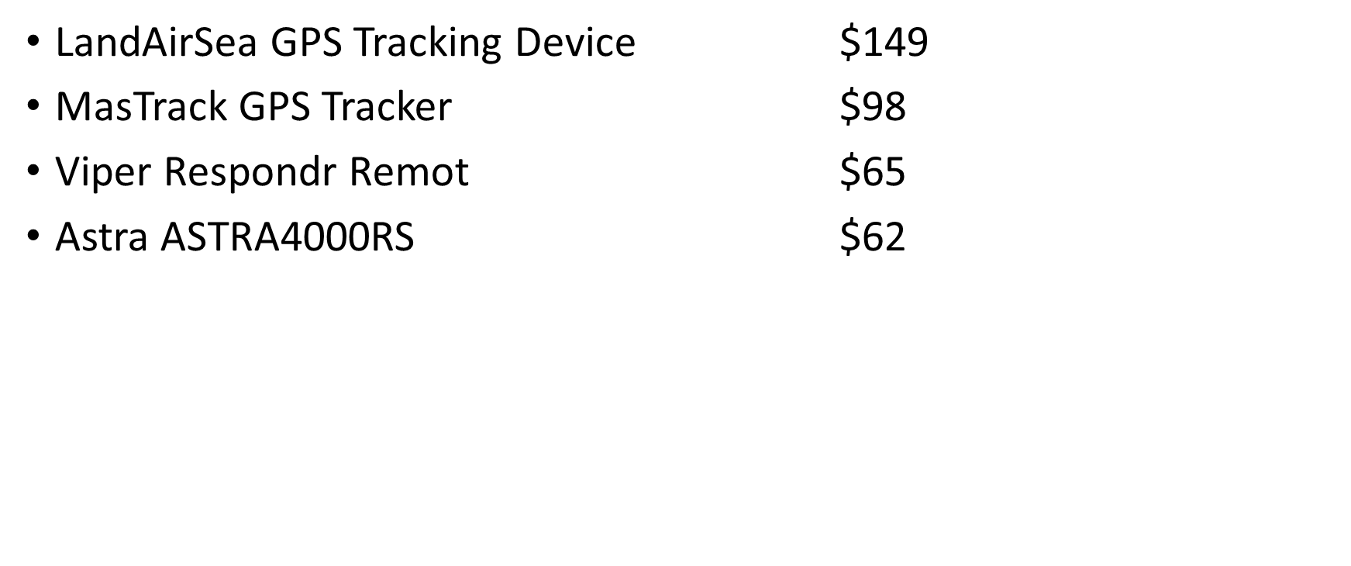
4. Collect & Arrange Data (Continued)
Potential Competitors

Slide 12
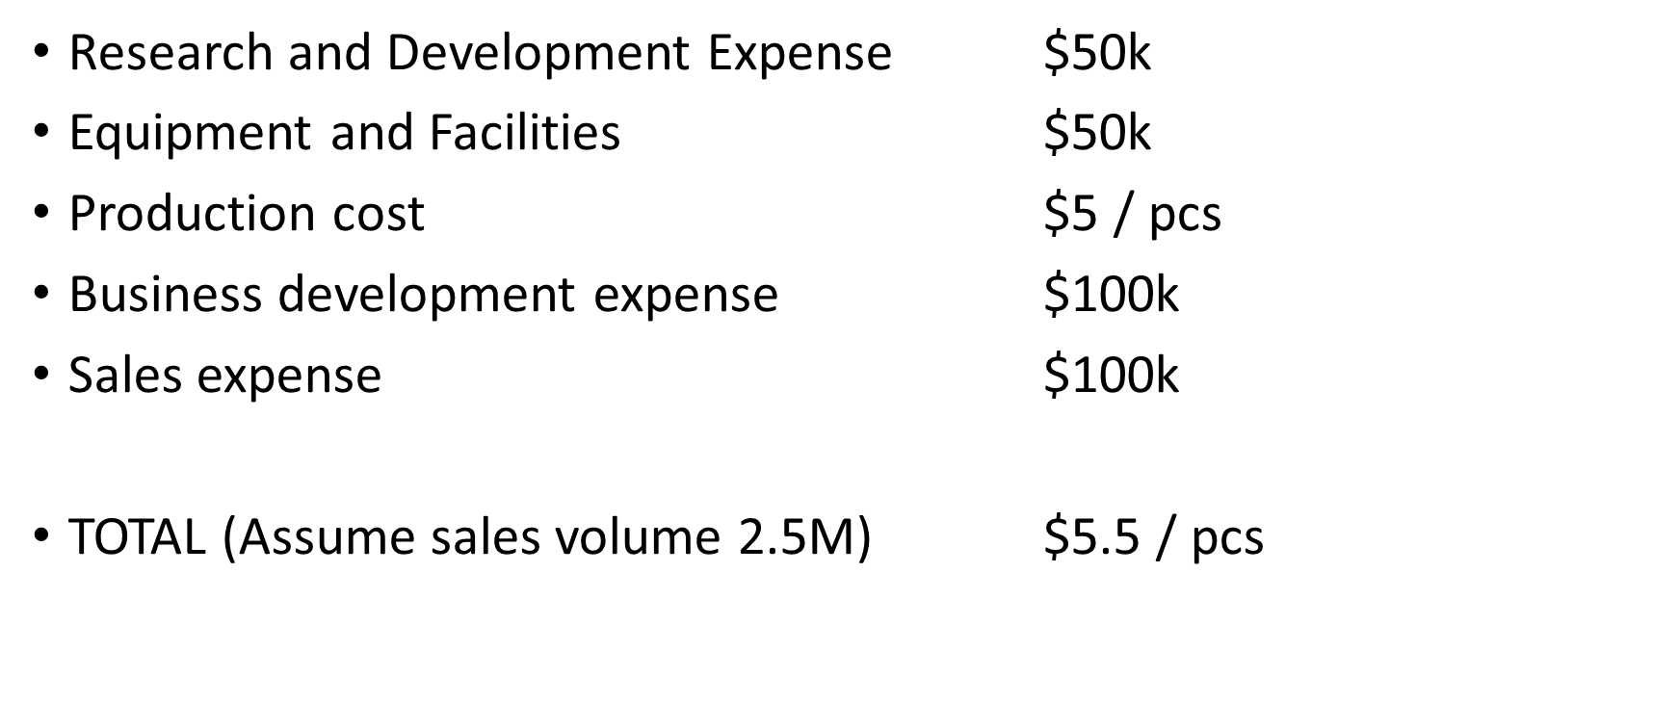
4. Collect & Arrange Data (Continued)
Product Cost

Slide 13
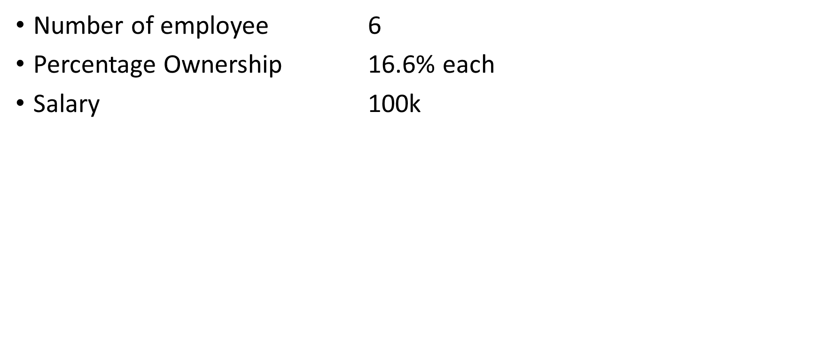
4. Collect & Arrange Data (Continued)
Organization

Slide 14
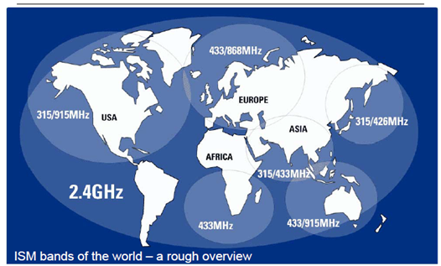
4. Collect & Arrange Data (continued)

Slide 15
5. Review Data
Cost of Product $5.5 / each
Price of Product $20 / each
Sales Volume $50M
Profit $30M

Slide 16
6. Considering the Intangibles
Customers entrust their possessions to be protected
Feel secure to keep property in the car (business and pleasure)
SmartKey notifies the customer to call 911 for help –
The customer is safe and calls the police to intervene the theft
Market Interest is the ‘Demand’ for SmartKey –
Automobiles, Trucks, Product acceptance, Low price point
Business Partnerships –
Top Vehicle Manufacturers (Honda, Toyota, General Motors, Ford, Nissan)
Parts Store at Vehicle Dealerships (central point-of-contact)
Reduced Risks –
Limit production costs and distribution costs with existing Dealership Networks
Notes:
Customers entrust their possessions to be protected by our product
Feel secure to keep property in the car (business and pleasure)
They decide what property to have with them, based on its necessity and convenience versus security.
SmartKey notifies the customer with a vibration and a light.
Then the customer can call 911 for help
The customer is safe and the police handle the theft intervention
Theft intervention is the essential benefit that our product provides.
Market Interest is the ‘Demand’ for our product
It’s success relies on a large market segment, business partnerships, and reduced risks.
Automobiles: Commuters and Travelers, Salesman
Trucks: Utility (Skilled-Workers), Delivery (Bonded Couriers), Tractor-trailer (Big-Rigs) trailer loads and cab electronics
Business Partnerships:
Parts Store at Vehicle Dealerships – Central point of contact
Automotive Stores: AutoZone, Napa Auto Parts …
Retail stores: Wal-Mart, Target, BestBuy
Risks – Product Acceptance and Price Point
Limit distribution costs with existing Retail Outlets
Limit production costs with existing Dealership Networks

Slide 17
No.1 Challenge – Establish Partnerships
Most Stolen Vehicles = Customer Dissatisfaction
Note #1 and #2 Vehicles Stolen: Honda Accord and Honda Civic
First Partnership: American Honda Motor Company
Reduce the Problem by Improving Security
Vehicle Manufacturer will improve their products with the SmartKey Technology
Their market volume will increase from the SmartKey Technology
Our Market Niche: Partnerships with Top Vehicle Manufacturers
Vehicle Manufacturer will invest in SmartKey total production costs
Vehicle Manufacturer will produce the Ignition Keys
Vehicle Manufacturer will distribute at their Dealerships
Notes:
Customers entrust their possessions to be protected by our product
Feel secure to keep property in the car (business and pleasure)
They decide what property to have with them, based on its necessity and convenience versus security.
SmartKey notifies the customer with a vibration and a light.
Then the customer can call 911 for help
The customer is safe and the police handle the theft intervention
Theft intervention is the essential benefit that our product provides.
Market Interest is the ‘Demand’ for our product
It’s success relies on a large market segment, business partnerships, and reduced risks.
Automobiles: Commuters and Travelers, Salesman
Trucks: Utility (Skilled-Workers), Delivery (Bonded Couriers), Tractor-trailer (Big-Rigs) trailer loads and cab electronics
Business Partnerships:
Parts Store at Vehicle Dealerships – Central point of contact
Automotive Stores: AutoZone, Napa Auto Parts …
Retail stores: Wal-Mart, Target, BestBuy
Risks – Product Acceptance and Price Point
Limit distribution costs with existing Retail Outlets
Limit production costs with existing Dealership Networks

Slide 18
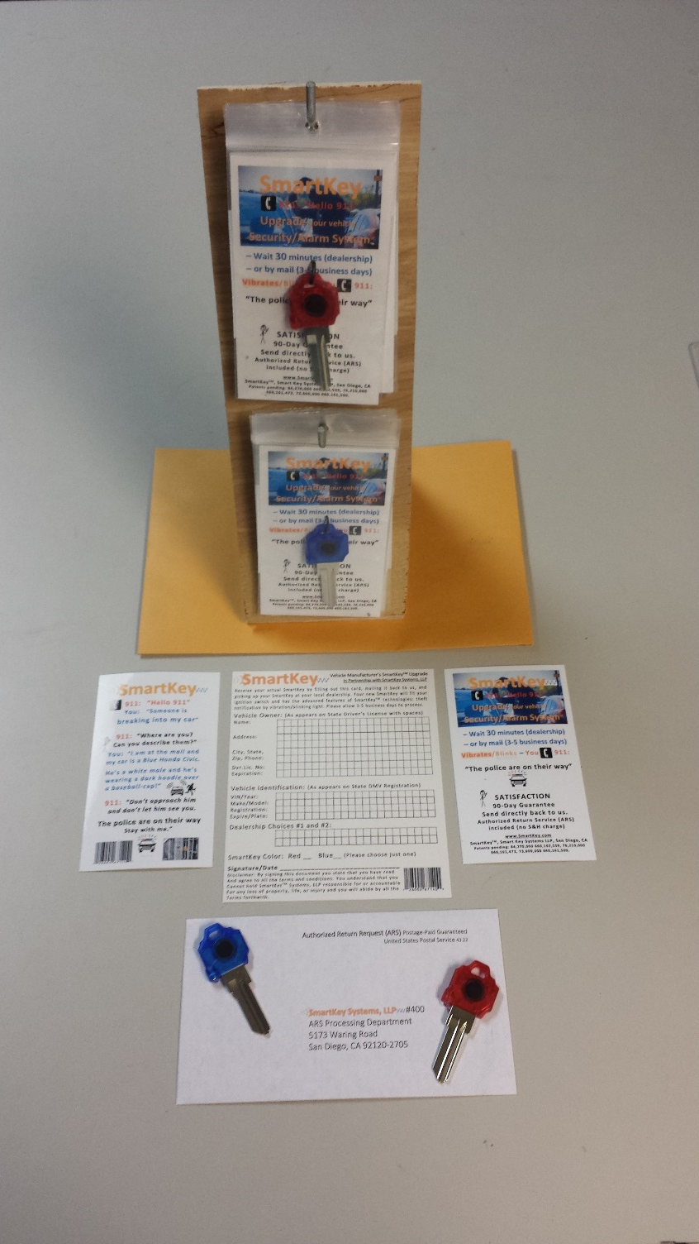
The product in stores
The product is a 3” x 5” packet that hangs for display in two colors.
A display stand takes up 4” x 5” of counter space for presentation.
Each packet contains:
Front panel (description)
Rear panel (instructions)
Key (product replica)
Registration Card (ignition-key order)
Notes:
The product is a 3” x 5” packet that hangs for display in two colors.
A display stand takes up 4” x 5” of counter space for presentation.
Each packet contains:
Front panel (description)
Rear panel (instructions)
Key (product replica)
Registration Card (ignition-key order, through SmartKey Systems, to the vehicle dealership, for the customer)

Slide 19
7. Making a Decision – For Each Partnership (Five Partnerships)
Gross Benefits: $2M = 100,000 x $20 per unit
Total Cost = $0.65M = $100K Startup + $550K Production
Net Benefits: $1.35M = $2M - $0.65M
ROI = 208% = $1.35M / $0.65M
Present Value (PV) = $1,000,000
Profitable: 5 months
Cost Benefit Ratio: 2.08 : 1
Notes:
We have several considerations to determine the cost effectiveness of this business endeavor. We calculate estimations of the Net Benefit, the ROI, the Present Value (PV), the Cost‑Benefit ratio, and the Profitability Index, shown below:
Market Volume = $2.5 million, estimated market volume (first year)
Target Volume = 25,000 units (1% of market volume)
Product Price = $100 per unit
Total Benefits = $2.5 million (25,000 units * $100 per unit) from product sales
6-Months Startup Costs = $100,000 for research, development, equipment, and facilities
6-Months Production Cost = $500,000, cost to produce 25,000 units * $20 unit cost
Total Cost (first year) = $600,000 (6-Months Startup Costs + 6-Months Production Cost)
Depreciation = $50,000 (10% per annum of capital equipment and inventory)
Useful life = Six-year predicted useful life of product and vehicle
Net Benefit = Total Benefits - Total Cost - Depreciation / Useful life
Net Benefit = $1.9 million ($2.5 million - $600,000 - $50,000 / 6 years)
Return-On-Investment = Net Benefit / Total Initial Investment
Return-On-Investment = 317% ($1.9 million / $600,000)
Payment = $54,000 annum = $4,500 Monthly ($600,000 loan at 3% SBA‑sponsored rate)
Present Value = Payment * - (1 - (1 + interest) ^{n}) / interest
Present Value = ($54,000 * - (1 - (1 + 6%) ^{30 years}) / 6% SBA‑sponsored rate)
Present Value = -$5,169,142 = ($54,000 * - 95.724) = ($54,000 * - (5.743 / 6%))
Cost benefit ratio = Total benefits / Total costs
Cost benefit ratio = 3.13:1 = $1.9 million / $600,000
Profitability index = 35.185 = $1.9 million (Present value) / $54,000 (investment)
Profitable the first year (five months after production starts)

Slide 20
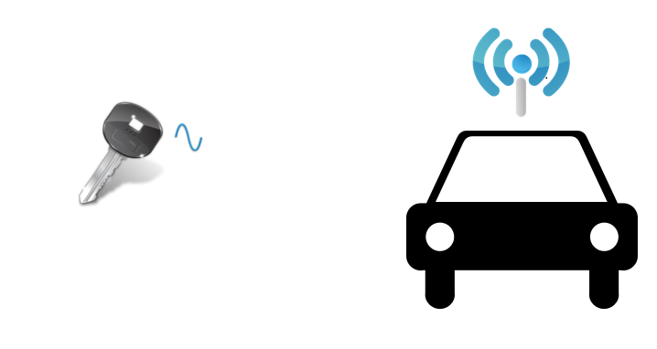
8. Develop Implementation Plan
Design:
Analog Multi-band one way RF broadcast
Signal receiver integrated in the car key

Slide 21
8. Develop Implementation Plan
1. Researches (3 months)
2. Product Planning (2 weeks)
3. Product Design (2 Months)
4. Product Productions (4 Months)
Prototype
Functional Prototype, Test
Redesign (Change)
Industrial Prototype, Test
Mass Production

Slide 22
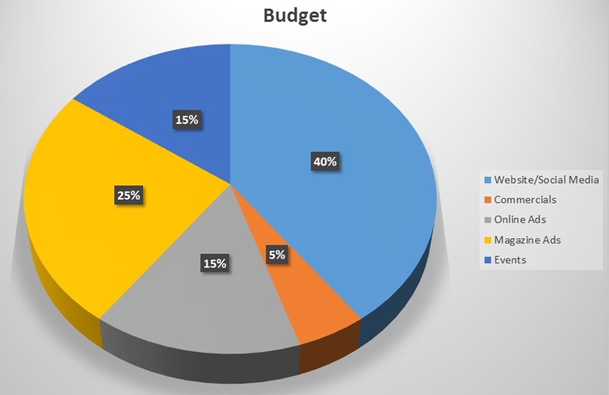
9. Marketing Strategy
Marketing Targets
Customers
Partnership
Marketing Tools
Website/Social Media
Online Ads
Magazine Ads
Events

Slide 23

10. Measure Success
Internally
Employees
Work Atmosphere
Growth
External
Market Impact
Customers
Image
New Customers
Customer Care
Image From: www.linkedin.com

Slide 24
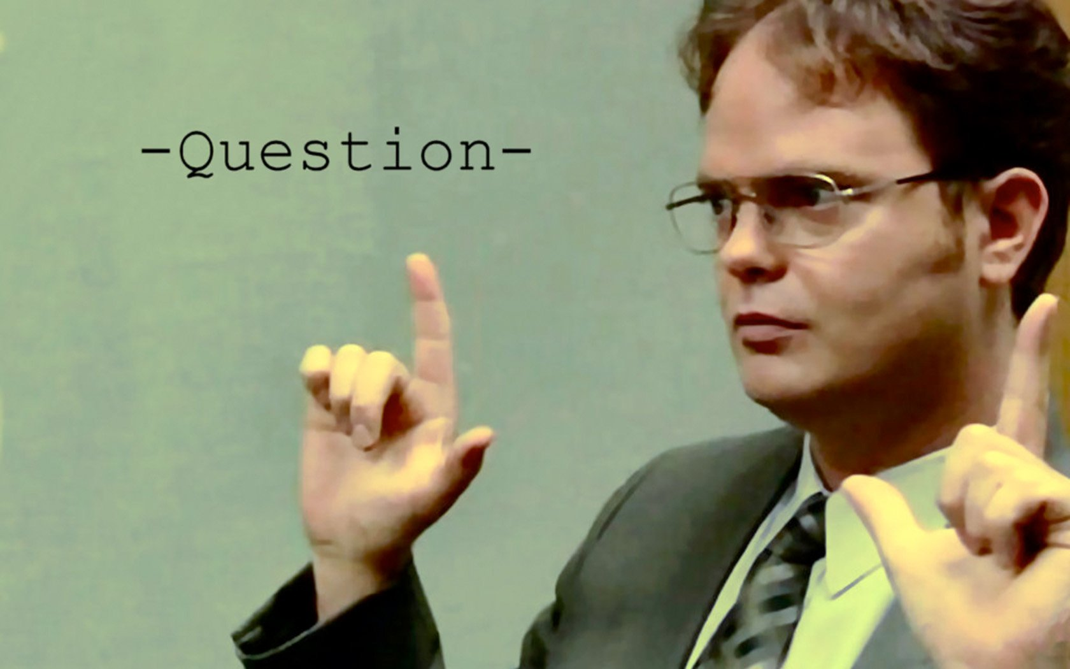
Question?

Slide 25
Thank you!

